Slide 1
GARBAGE MANAGEMENT SYSTEM FOR A SMART CITY
Submitted by
KIRAN RAJ & KRISHNANUNNI
I9MCA

Slide 2
EXISTING SYSTEM
The current garbage collection system includes routine garbage trucks doing rounds.
It is a system that will take days or weeks to cover every zone in the City.
Moreover, this will lead to an increase in the waste day by day.

Slide 3
PROPOSED SYSTEM
We propose a network of smart bins that integrates cloud-based techniques to monitor and analyze data collected to provide predictive routes generated through algorithms for garbage trucks.
An android app is developed for the workforce and the citizens, which provides the routes for the workforce and thereby achieving efficient collection of waste.

Slide 4
PROBLEM DEFINITION
Garbage pollution is a major environmental threat today.
People tend to dispose this waste in unethical ways such as throwing them into the river, burying them and burning which worsens the situation this happens due to, lack of awareness about proper methods of waste disposal.
Disposal facilities does not reach every citizen. The payment for the service is in convenient as well.

Slide 5
OBJECTIVE OF THE PROJECT
We plan to make a smart and green city so that the people wont dump their wastes in public places and pollute the air and water resourses, and also the proper disposal of wastes to save the earth.

Slide 6
SCOPE OF THE PROJECT
Garbage pollution is a major environmental threat today.
People tend to dispose this waste in unethical ways such as throwing them into the river, burying them and burning which worsens the situation this happens due to, lack of awareness about proper methods of waste disposal.
Disposal facilities does not reach every citizen.
The payment for the service is in convenient as well.

Slide 7
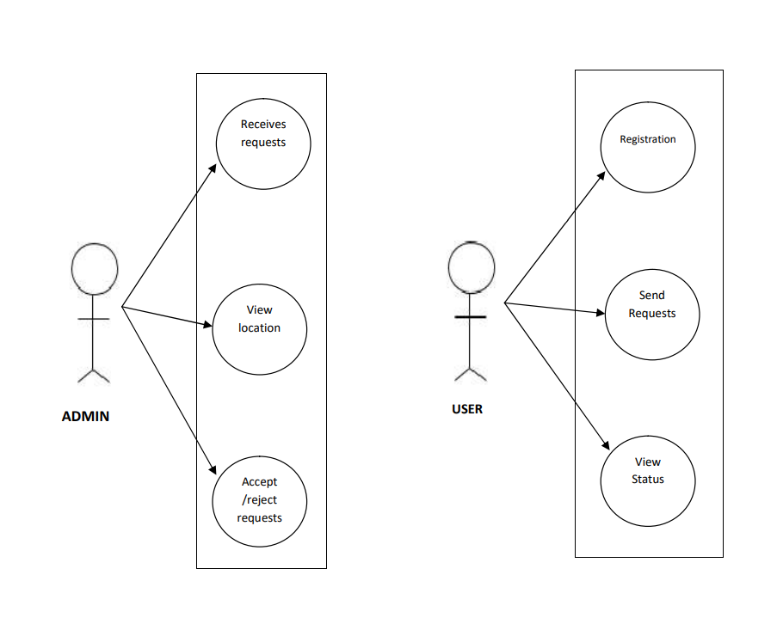
USE CASE DIAGRAM

Slide 8
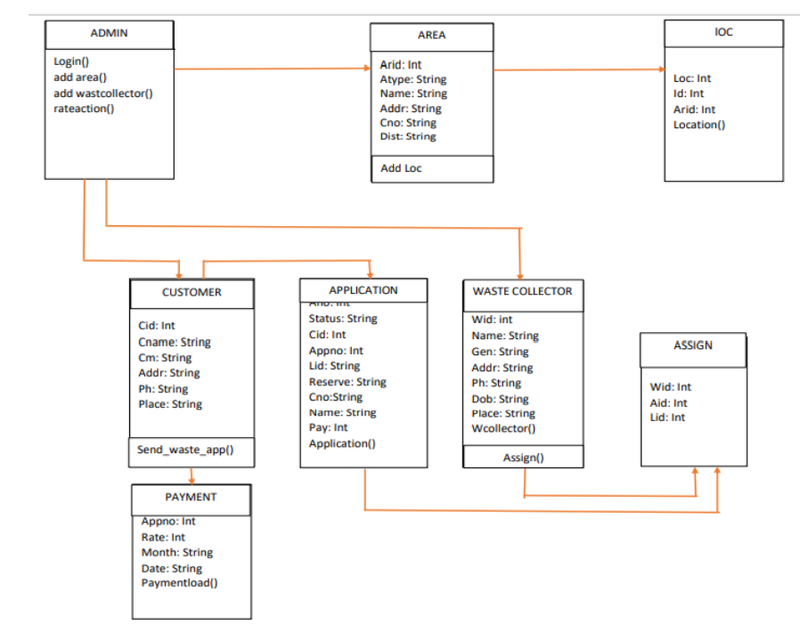
CLASS DIAGRAM

Slide 9
THANK YOU

